Slide 1
Stanford Introduction to Food and Health
Edlenko Sergey

Slide 2
Course structure
Background on Food & Nutrients
Contemporary Trends in Eating
Future Directions in Health - Part 1
Future Directions in Health - Part 2
Cooking Workshop & Recommended Optional Resources

Slide 3
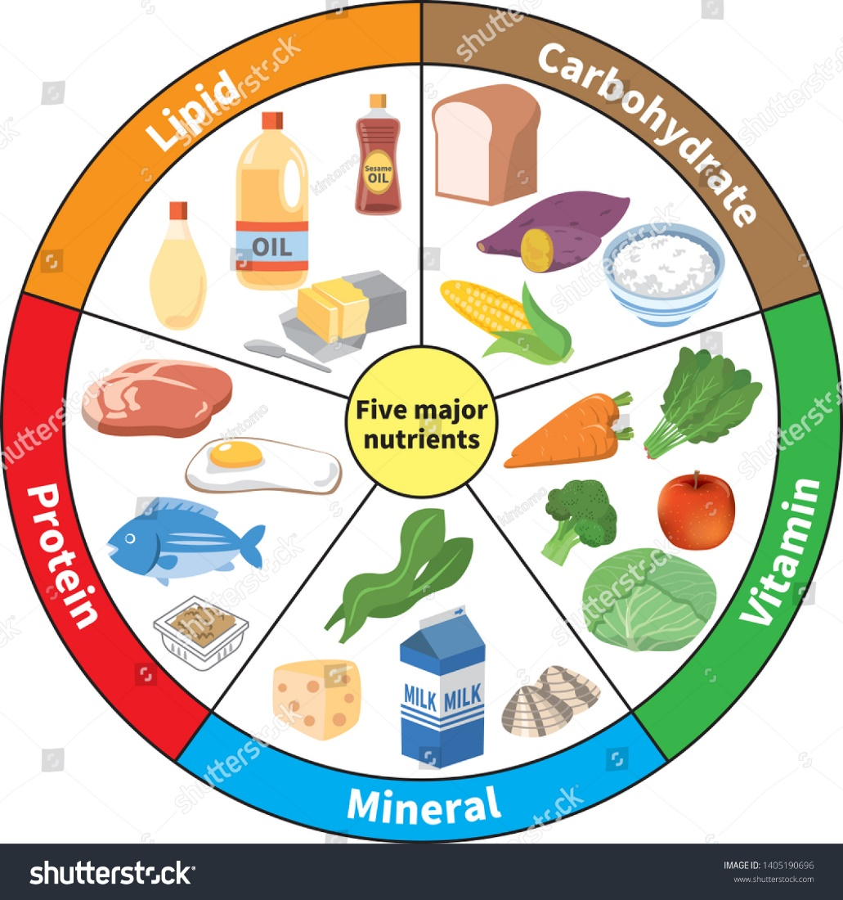
Background on Food & Nutrients
A Sociocultural History of Obesity
Macronutrient Structure & Metabolism
Carbohydrate-rich Foods & the Glycemic Index
Animal & Plant-based Proteins
Dietary Fats & Their Effects on Human Health

Slide 4
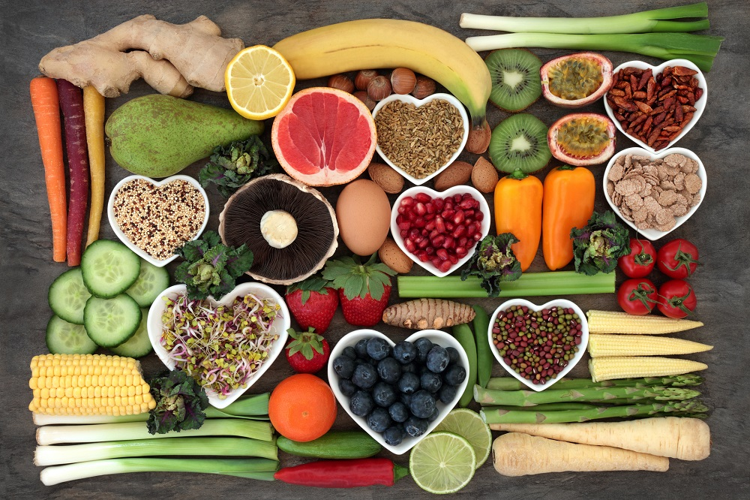
Contemporary Trends in Eating
Why Are Highly Processed Foods Generally Less Healthy?
Why Are Highly Processed Foods Generally Less Healthy?
Macronutrient Structure & Metabolism
The Case for Cooking
A Case Study: Middle-aged Pre-diabetic Man
A Step-wise Approach to Behavior Change

Slide 5

Future Directions in Health - Part 1
Eat Food. Not Too Much. Mostly Plants.
Cooking: Fundamental Ingredients
Cooking: Increasing Vegetable Intake
Cooking: Sensible Substitutions

Slide 6
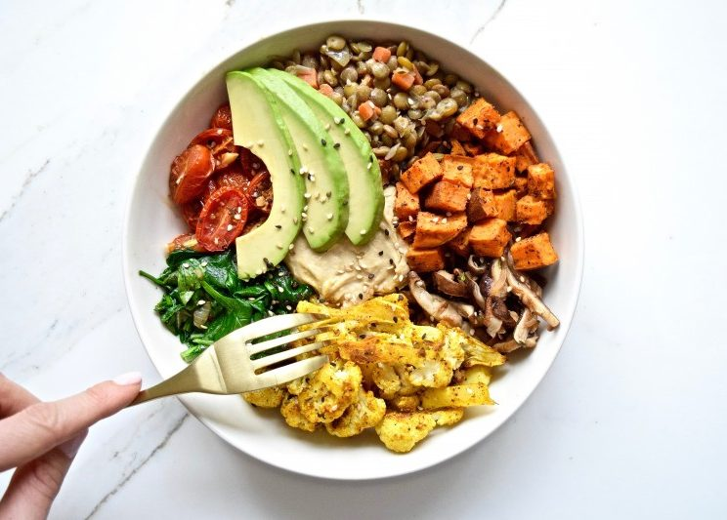
Future Directions in Health - Part 2
Constructing a Healthy Plate
Shopping in a Supermarket
Reading Nutrition Labels
The Importance of Moderation in Maintaining a Healthy Diet

Slide 7
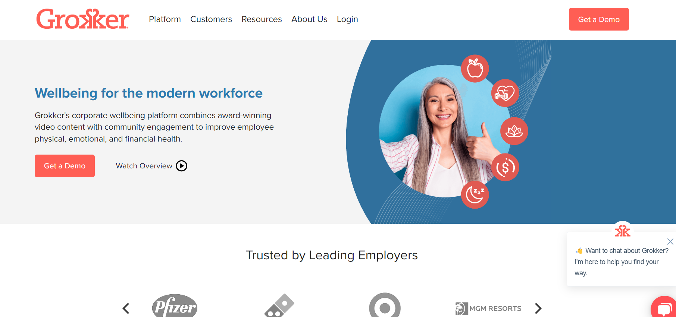
Cooking Workshop & Recommended Optional Resources
Free calorie counter, diet and exercise tracker: https://www.myfitnesspal.com/
Yoga, fitness, and cooking video classes: https://grokker.com/
Food-related, science-based health news http://www.responsiblefoods.org/
Evidence-based nutrition recommendation: http://www.hsph.harvard.edu/nutritionsource/

Slide 8
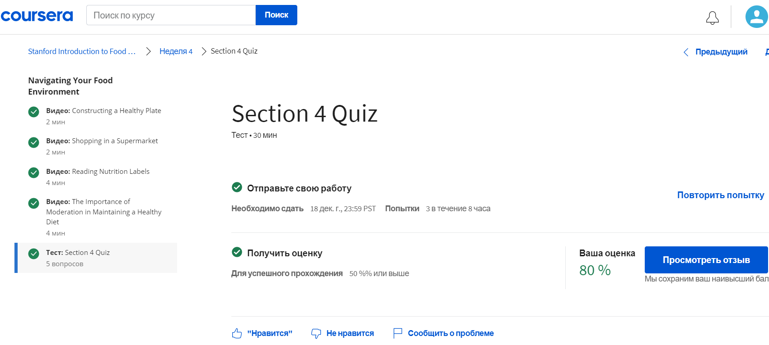
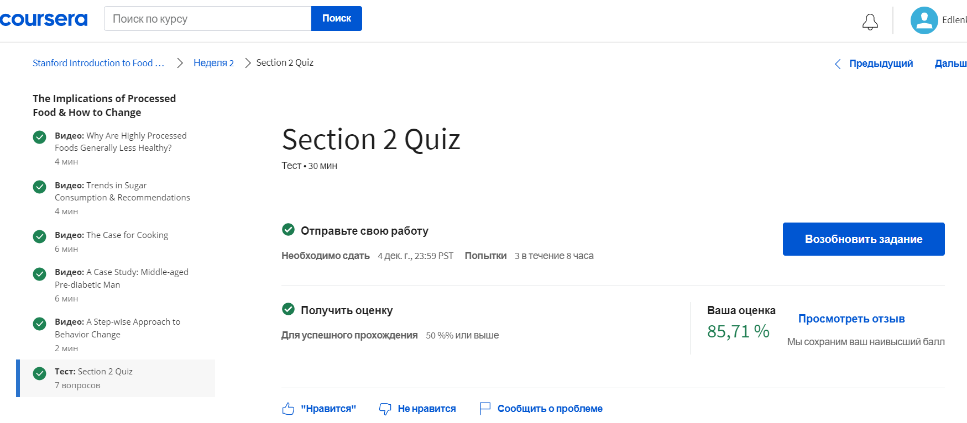

Slide 9
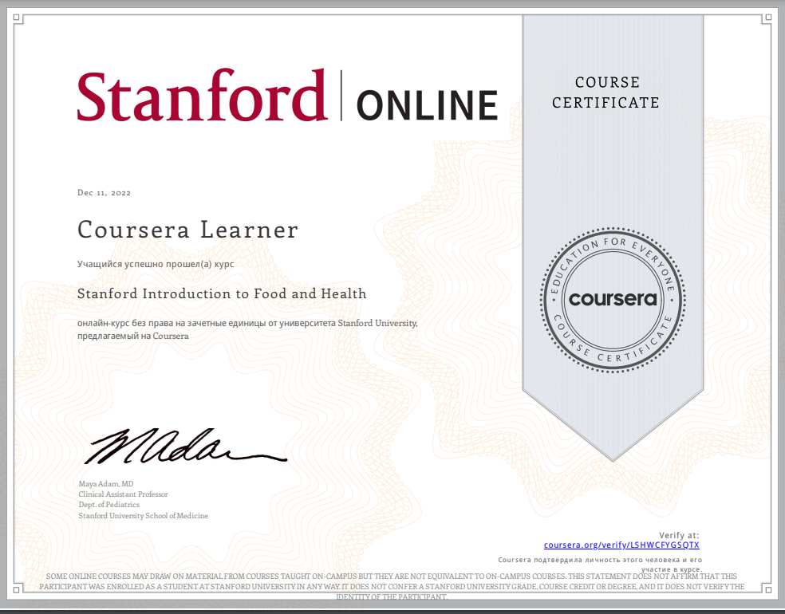

Slide 10
Contacts
Email
edlenko@sfedu.ru
Phone number
+7(961)5025040
Course
https://www.coursera.org/learn/food-and-health

